Slide 1
SNHU CS250 Agile Presentation By: John Brungard

Slide 2

The Agile Team

Slide 3


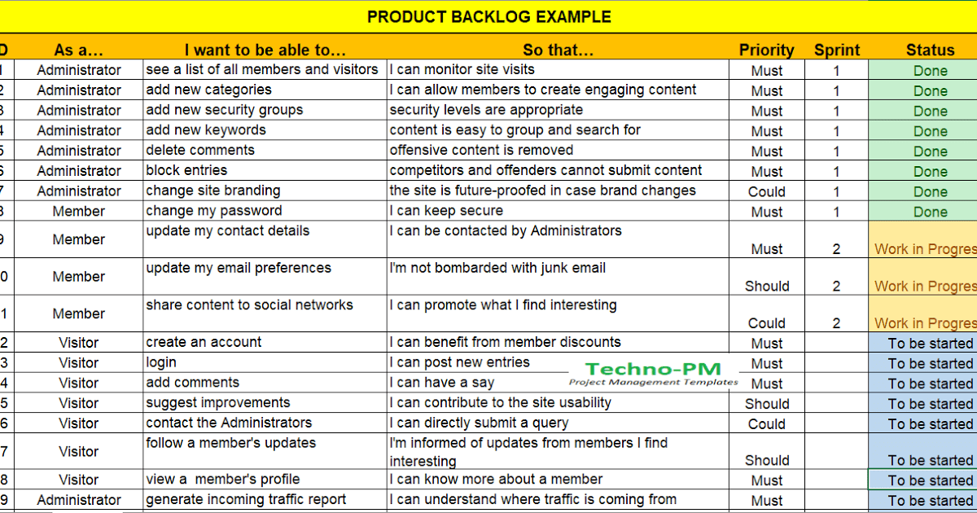
Sample 1
The Product Owner
Retrieved from techno-PM.com
Defines User Stories for features the end user values.
Creates and prioritizes the Product Backlog as a project progresses.
Reviews and accepts “done” User Stories or requirements.
Acts as the primary communicator between clients and teams.

Slide 4

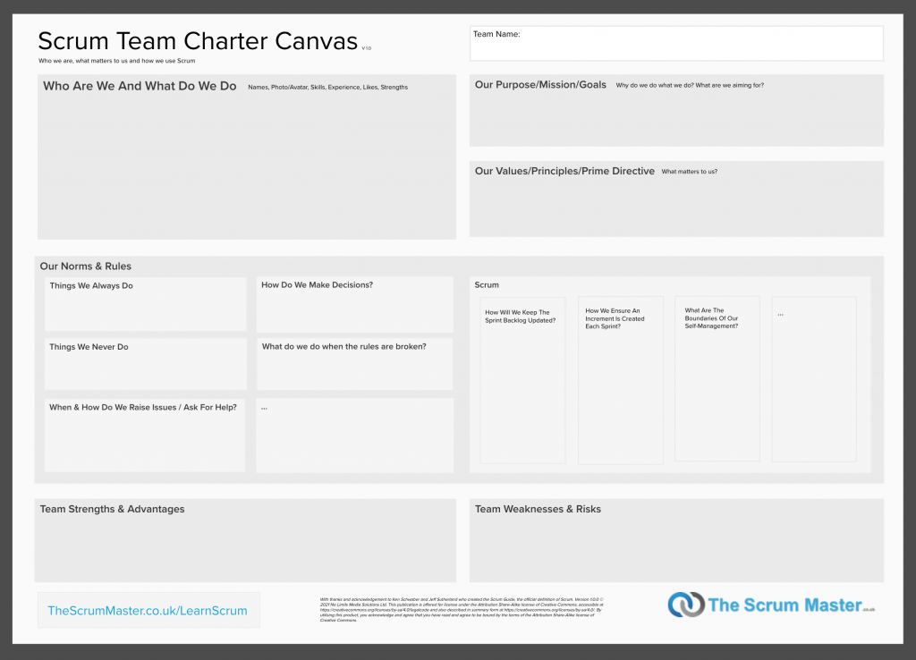
Sample 5
The
Scrum Master
Works with the team to create an Agile Team Charter.
Facilitates Agile meetings such as the Daily Scrum Meeting.
Assists the Product Owner with maintaining the Product Backlog.
Instills and follows Agile Principles amongst the team members.

Slide 5

Sample 3
Developers
Testers
Estimates User Stories to develop a Sprint Backlog.
Creates a list of tasks to be taken into a following Sprint.
Creates deliverables of the project to share with the Product Owner and Client.
Identifies areas of improvement during Retrospectives.
Reports and updates progress during meetings and with Agile tools.
Develops test cases for each User Story to include steps taken by the user and pass/fail measures.
Revises test cases as necessary during the project’s progression.
Communicates with the Product Owner to eliminate uncertainties and increase test value.
NOTE: Developers and Testers are defined under the same role and their duties are usually interchangeable.

Slide 6

Sample 7
Scrum-Agile SDLC Phases
Step 1: Initial Client Meetings
Step 3: Sprint Execution
Step 4: Sprint Review
The Client and Product Owner meet to discuss the Client’s proposal and features for a product.
The Product Owner defines User Stories based on the Client’s requests and prioritizes them within a Product Backlog.
Development begins as the team begins working on tasks taken into the Sprint.
The team uses Agile tools such as a Burndown Chart and a Kanban Board to track the progress of tasks and User Stories.
Meetings vital to Agile development such as the Daily Meeting occur. This is a time for developers to further track progress and discuss impediments with their team.
The project is being tested and constructed as a deliverable incrementally as the Sprint progresses.
User Stories and tasks are being added, updated or removed as more information becomes available concerning the project.
Sprint Reviews are where the Agile team showcases the product and gathers feedback from investors or customers at the end of a Sprint.
The Agile team also reflects on what they could have done to improve the product and what they did well.
Note: All information regarding Agile phases was obtained from the following class material:
Cobb, C. G. (2015). The Project Manager’s Guide to Mastering Agile: Principles and Practices for an Adaptive Approach (1st ed.) [E-book]. Wiley.
Step 2: Sprint Planning
Step 5: Sprint Retrospective
The Scrum Master organizes the team and creates an Agile Team Charter.
The development team analyzes the Product Backlog and compiles a Sprint Backlog on tasks they estimate can be completed in a Sprint.
This step occurs before every Sprint.
Sprint Retrospectives offer a deeper reflection on the Sprint than the review as the team covers what they will focus on for the next sprint.
The Agile team goes into greater detail on what was detrimental, adequate and successful concerning the project’s progression.

Slide 7

Sample 6
Waterfall Method
Step 1: Feasibility Study
“The main goal of this phase is to determine whether it would be financially and technically feasible to develop the software”. (GeeksforGeeks. (2022, March 2). Software Engineering | Classical Waterfall Model. )
This step in the SNHU Travel Project would have included major documentation of the project including its benefits, drawbacks, possible solutions, etc. compared to the minimal initial planning of an Agile Method.
Step 2: Requirements Analysis and Specification
”The aim of the requirement analysis and specification phase is to understand the exact requirements of the customer and document them properly”. (GeeksforGeeks. (2022, March 2). Software Engineering | Classical Waterfall Model.)
This step is somewhat like Agile Development though requirements are put into a Software Requirement Specification(SRS) Document instead of a Product Backlog. The SRS rarely changes and is the contract between the team and client.
Step 3: Design
“The goal of this phase is to convert the requirements acquired in the SRS into a format that can be coded in a programming language”. (GeeksforGeeks. (2022, March 2). Software Engineering | Classical Waterfall Model. )
Waterfall Designs are linear to where development changes to the project are not considered until the end of the project, which leaves the risk of some previously completed work becoming waste. (Lucid Content Team. (2018, August 10). The Pros and Cons of Waterfall Methodology. https://www.lucidchart.com/blog/pros-and-cons-of-waterfall-methodology)
NOTE: The Waterfall Method is also referred to as Traditional Project Management or Classical Project Management.

Slide 8
Sample 6
Waterfall Method (CONT.)
Step 4: Develop
“In the coding phase software design is translated into source code using any suitable programming language. Thus, each designed module is coded”.(GeeksforGeeks. (2022, March 2). Software Engineering | Classical Waterfall Model. )
Coding is done sequentially, meaning testing occurs only when the coding is considered “done” versus Agile Development where testing is done concurrently with development.
Step 5: Testing
“Integration of different modules are undertaken soon after they have been coded and unit tested…Finally, after all the modules have been successfully integrated and tested, the full working system is obtained, and system testing is carried out on this. (GeeksforGeeks. (2022, March 2). Software Engineering | Classical Waterfall Model. )
The client has little to no interaction with the project until they perform an Acceptance test at the very end of the project.
Step 6: Deploy and Maintain
The Software is delivered to the real environment after being fully tested and accepted. From there, ongoing maintenance is usually performed to include corrective, adaptive, perfective and preventative steps to ensure the program runs smoothly.
This Maintenance stage is focused on a reactive approach to where developers immediately correct any issues not identified or solved in previous steps. This is contrary to the proactive approach used in the SNHU Travel Project where development phases were performed concurrently to address problems before becoming an issue near the end of a project or afterwards.
NOTE: The steps of the Waterfall Method may be named or grouped differently by varying institutions/users, but they all follow the same sequential processes and principles.

Slide 9
Sample 2
Agile vs. Waterfall
Round 1: Project Complexity
“Instead of planning everything upfront, agile management follows a more adaptive and collaborative approach. It’s further divided into different frameworks that are suitable for different kinds of projects”. (Waseem, A. (2022, July 17). Waterfall Vs Agile Project Management. Management Library. https://managementhelp.org/waterfall-vs-agile)
“Agile Development has a better ability to manage changing priorities, has a higher project risk reduction and is better used when certain details aren’t known from the get-go”. (C. (2022, June 15). What Is Agile? And When to Use It. Coursera. https://www.coursera.org/articles/what-is-agile-a-beginners-guide)
“This model works well for smaller projects and projects where requirements are well understood”. (GeeksforGeeks. (2022, March 2). Software Engineering | Classical Waterfall Model. )
“The Waterfall Method works well when the scope, timeline, and risks are clearly identified within a project”. (Waseem, A. (2022, July 17). Waterfall Vs Agile Project Management. Management Library. https://managementhelp.org/waterfall-vs-agile)

Slide 10
Sample 2
Agile vs. Waterfall
Round 2: Flexibility of Timelines/Budgets
“Has a flexible budget. Increases funding efficiency. (Waseem, A. (2022, July 17). Waterfall Vs Agile Project Management. Management Library”. https://managementhelp.org/waterfall-vs-agile)
“Has no fixed timeline. Better for longer or continuous projects that require greater innovation”. (Waseem, A. (2022, July 17). Waterfall Vs Agile Project Management. Management Library. https://managementhelp.org/waterfall-vs-agile)
“Not flexible. Waterfall projects are fully planned out in the initial stages and different phases cannot overlap”. (Waseem, A. (2022, July 17). Waterfall Vs Agile Project Management. Management Library. https://managementhelp.org/waterfall-vs-agile
“Has a fixed budget. Involves less risk since the budget is finalized upfront”. (Waseem, A. (2022, July 17). Waterfall Vs Agile Project Management. Management Library. https://managementhelp.org/waterfall-vs-agile
“Has a fixed timeline. Better for short-term projects”. (Waseem, A. (2022, July 17). Waterfall Vs Agile Project Management. Management Library. https://managementhelp.org/waterfall-vs-agile

Slide 11
Sample 2
Agile vs. Waterfall
Round 3: Adaptability
“Very flexible. Allows for innovation and collaboration and makes it easy to change project courses”. (Waseem, A. (2022, July 17). Waterfall Vs Agile Project Management. Management Library. https://managementhelp.org/waterfall-vs-agile)
“In Agile processes, there is constant feedback, allowing for team members to adjust to challenges as they arise, and stakeholders an opportunity to communicate consistently”. (C. (2022, June 15). What Is Agile? And When to Use It. Coursera. https://www.coursera.org/articles/what-is-agile-a-beginners-guide)
“This model assumes that all the customer requirements can be completely and correctly defined at the beginning of the project, but actually customers’ requirements keep on changing with time”. (GeeksforGeeks. (2022, March 2). Software Engineering | Classical Waterfall Model. )
“You’ll have put a considerable amount of work into a project under very specific, rigid assumptions. A sudden change to the parameters of the project could render much of the work you’ve carried out up to that point useless, which can throw off the entire timeline”. (Lucid Content Team. (2018, August 10). The Pros and Cons of Waterfall Methodology. https://www.lucidchart.com/blog/pros-and-cons-of-waterfall-methodology)

Slide 12
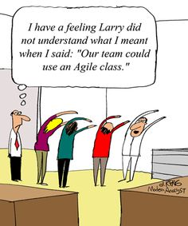
Sample 4
References
GeeksforGeeks. (2022, March 2). Software Engineering | Classical Waterfall Model. https://www.geeksforgeeks.org/software-engineering-classical-waterfall-model/
Lucid Content Team. (2018, August 10). The Pros and Cons of Waterfall Methodology. https://www.lucidchart.com/blog/pros-and-cons-of-waterfall-methodology
Waseem, A. (2022, July 17). Waterfall Vs Agile Project Management. Management Library. https://managementhelp.org/waterfall-vs-agile
C. (2022, June 15). What Is Agile? And When to Use It. Coursera. https://www.coursera.org/articles/what-is-agile-a-beginners-guide
Cobb, C. G. (2015). The Project Manager’s Guide to Mastering Agile: Principles and Practices for an Adaptive Approach (1st ed.) [E-book]. Wiley.

Slide 13





Call To Action Slide
100,000+ cutout people images.
Get FREE access to 1,000s of character images.
CLICK HERE
to Check Out the Cutout People Library!

